Slide 1
Data Structures

Slide 2
Agenda
Lowest Common Ancestor in a Binary Tree
Lowest Common Ancestor in a BST
Left View of a Binary Tree
Left View of a Binary Tree – Iterative
Vertical Traversal of a Binary Tree
Root to Leaf Path Sum

Slide 3
Lowest Common Ancestor in a Binary Tree
This code works for all Binary Trees.
Does this work for a BST? -> Yes it does.

Slide 4
Lowest Common Ancestor in a BST
We can do better than the earlier approach.

Slide 5
Left View of a Binary Tree

Slide 6
Left View of a Binary Tree - Iterative
Queue.size() will give us the number of elements at a level.

Slide 7
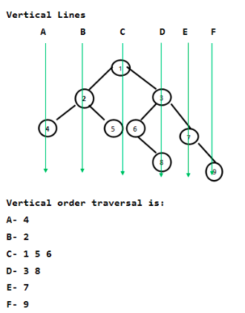
Vertical Traversal of a Binary Tree

Slide 8
Root to Leaf Path Sum
Link: https://practice.geeksforgeeks.org/problems/root-to-leaf-path-sum/1/

Slide 9
All Paths from root with a specified sum
Link: https://practice.geeksforgeeks.org/problems/paths-from-root-with-a-specified-sum/1/

Slide 10
Max Path Sum
Link: https://practice.geeksforgeeks.org/problems/maximum-path-sum-from-any-node/1/

Slide 11
Max Path Sum

Slide 12
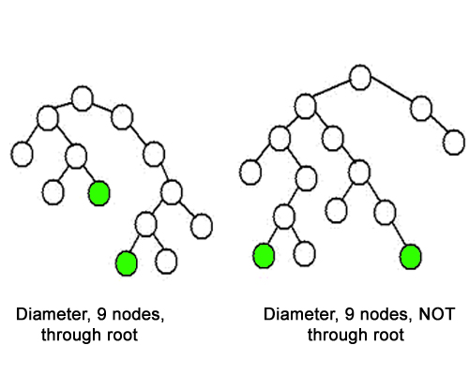
Diameter of a Binary Tree
Link: https://practice.geeksforgeeks.org/problems/diameter-of-binary-tree/1/

Slide 13
Diameter of a Binary Tree
Link: https://practice.geeksforgeeks.org/problems/diameter-of-binary-tree/1/

Slide 14
THANK YOU

